Slide 1
January 12, 2021 | MC Teleconference
Clarify Tariff Section III.A.18 Reference to Code of Conduct Standards for IMM
Restating Specific IMM Ethics Standards
Timothy Helwick
413-535-4485 | thelwick@iso-ne.com

Slide 2
Clarify Tariff Section III.A.18 Reference to Code Conduct Standards for IMM
WMPP ID:
154
Proposed Effective Date: May 2021
Order 719, as codified in 18 C.F.R. § 35.28(g)(3)(vi), requires that the Tariff include seven specific Market Monitoring Unit ethical conduct standards to prevent conflicts of interest (see Appendix)
Currently the Tariff lists a couple standards and attaches the ISO’s Code of Conduct for the other standards.
prohibition on employment -- serving as an officer, employee or partner of a market participant, or
prohibition on compensation for services/expert testimony
For clarification, the ISO proposes to list the five other minimum standards in the Tariff and to no longer attach (as Exhibit 5 to Appendix A) to the Tariff the Code of Conduct for this purpose
no material affiliation with, or financial interest in, a market participant, no engaging in market transactions, no non-de minimis gifts, required disclosure/disqualification if seeking employment from a market participant
This presentation will clarify how removing the Code of Conduct is consistent with the requirements of the Commission and Participant’s Agreement and highlight the proposed redline revisions stating the minimum Market Monitoring ethics requirements as discussed at the December 8, 2020 MC meeting

Slide 3
Code of Conduct Consistent with Requirements of the Commission and Participant’s Agreement
As stated in the Participant’s Agreement, the ISO will continue to have a Code of Conduct complying with Commission requirements
9.3 Conflict of Interest Policy.
9.3.1 Code of Conduct. To ensure the independence of ISO, ISO shall adopt and enforce a Code of Conduct, which will comply with the requirements of the Commission. No director of ISO shall be affiliated with any Governance Participant in the New England Control Area in violation of the Code of Conduct.
The ISO’s Code of Conduct is not changing as a result of this proposal
Not aware of any express requirement to file Code as part of the Tariff
Minimum IMM/EMM ethics standards, consistent with the Code of Conduct, will be explicit in the Tariff, as required by federal regulation
Just no longer attaching the Code of Conduct for this purpose

Slide 4
Proposed Clarification
Restated from
12/8/20 MC Meeting
Clarify Code of Conduct Reference and Add Specific IMM Ethics Requirements
1) Clarify the reference to the Code of Conduct in the Tariff to explain that the Code is occasionally updated;
(2) Specify in the Tariff language (not by attaching the Code of Conduct) the minimum IMM ethic standards; and
(3) Given 1 and 2, no longer attach Code of Conduct to the Tariff

Slide 5
Redline of Proposed Tariff Changes
Restated from
12/8/20 MC Meeting
Section | Change | Description
III.13.A.18.1. Compliance with ISO New England Inc. Code of Conduct | Add “as amended from time to time and available on the ISO’s website” plus spell out the 5 other minimum ethics standards. Delete Exhibit 5. | Clarify that the ISO amends its Code of Conduct from time-to-time, the filed version may be out of date but the minimum ethics requirements remain the same. Not necessary to file each updated Code of Conduct as a Tariff exhibit.
III.A.18.1. Compliance with ISO New England Inc. Code of Conduct.
The employees of the ISO that perform market monitoring and mitigation services for the ISO and the employees of the External Market Monitor that perform market monitoring and mitigation services for the ISO shall execute and shall comply with the terms of the ISO New England Inc. Code of Conduct attached hereto as Exhibit 5., as amended from time to time and available on the ISO’s website. Consistent with the Code of Conduct, at a minimum each such monitoring unit and its employees (a) must have no material affiliation with any market participant or affiliate, (b) must have no material financial interest in any market participant or affiliate with potential exceptions for mutual funds and non-directed investments, (c) must not engage in any market transactions other than the performance of their duties hereunder, (d) may not accept anything of value from a market participant in excess of a de minimis amount, and (e) must advise a supervisor in the event they seek employment with a market participant, and must disqualify themselves from participating in any matter that would have an effect on the financial interest of the market participant.

Slide 6
Conclusion
Changes will add clarity
Tariff Appendix A should be amended to reflect that the Code of Conduct is subject to change and available on the website
No need to reference attached Code of Conduct because minimum ethics standards will be stated in the Tariff, with the more stringent standards applying in the event of a conflict
Delete Exhibit 5 (or indicate superseded)

Slide 7
Next Steps
Vote on these proposed Tariff revisions at the February 2021 Markets Committee meeting and at the March 2021 Participants Committee meeting
Make a filing in eTariff by April 2021 to make all Tariff changes necessary to reflect the revisions to Tariff Sections III.A.18.1 and III.A.18.2.

Slide 8
Stakeholder Schedule
Stakeholder Meetings | Scheduled Project Milestone
December 8, 2020 Markets Committee | Discussion on proposed Tariff revisions associated with IMM Ethical Conduct Standards
January 12, 2021 Markets Committee | Discussion on proposed Tariff revisions associated with IMM Ethical Conduct Standards
February 9-10, 2021 Markets Committee | Vote on proposed Tariff revisions associated with IMM Ethical Conduct Standards
March 4, 2021 Participants Committee | Vote on proposed Tariff revisions associated with IMM Ethics Standards
April 2021 | eTariff Filing

Slide 10
Appendix

Slide 11
Background
Order 719 as codified in Code of Federal Regulation
Under Order 719/Reg 35.28(g)(3)(vi)((A)-(G)), Tariff must include 7 minimum ethics standards for IMM:
(A) no material affiliation with, or (C) financial interest in, a market participant,
(B) cannot serve as an officer, employee or partner of a market participant,
(D) no engaging in market transactions outside duties,
(E) no compensation for expert testimony/services other than from ISO in connection with ISO matters;
(F) no non-de minimis gifts, and
(G) required disclosure/disqualification if seeking employment from a market participant.

Slide 12
Background
Current Tariff provisions
Tariff Section III.A.18.2 sets forth two of the required IMM ethics standards from Order 719/Reg. 35.28(vi)
Tariff Section III.A.18.1 also attaches as Exhibit 5 to Appendix A the ISO’s Code of Conduct (as of 7/1/2011), which sets forth among other things the five other minimum ethics standards for the IMM (which also apply to other ISO employees)

Slide 13
Background, cont.
Regulatory ethics standards and their location in Tariff or attached Code of Conduct
Regulatory Minimum Ethics Standards for IMM | Tariff Reference
(A) No material affiliation with a market participant | Section III.A, Exhibit 5 – Code of Conduct, Section 2.2 – No Association with Market Participants
(B) Cannot serve as an officer, employee or partner of a market participant | Section III.A.18.2.1 – Prohibition on Employment with a Market Participant
(C) No financial interest in a market participant | Section III.A, Exhibit 5 – Code of Conduct, Section 2.1 – No Prohibited Financial Interests
(D) No engaging in market transactions outside duties | Section III.A, Exhibit 5 – Code of Conduct, Section 2.3 – Non-Participation in Market Transactions
(E) No compensation for expert testimony/services other than from ISO in connection with ISO matters | Section III.A.18.2.2 – Prohibition on Compensation for Services
(F) No non-de minimis gifts | Section III.A, Exhibit 5 – Code of Conduct, Section 2.6 – Other Conflicts of Interest
(G) Required disclosure/disqualification if seeking employment from a market participant

Slide 14
Current Tariff excerpts
Tariff III.A.18 sets forth required IMM Ethics Standards in two ways:
First, Section III.A.18.1, Compliance with ISO new England Inc. Code of Conduct, states:
“The employees o the ISO that perform market monitoring and mitigation services for the ISO and the employees of the External Market Monitor that perform market monitoring and mitigation services for the ISO shall execute and comply with the terms of the ISO New England Inc. Code of Conduct attached hereto as Exhibit 5.”
Second, Section III.A.18.2, Additional Ethical Conduct Standards, states:
“The employees of the ISO that perform market monitoring and mitigation services for the ISO and the employees shall also comply with the following additional ethical conduct standards. In the event of a conflict between one or more standards as set forth below and one or more standards contained in the ISO New England Inc. Code of Conduct, the more stringent standard(s) should control.”
III.A.18.2.1 Prohibition on Employment with a Market Participant. “No such employee shall serve as an officer, director or employee or partner of a Market Participant”
III.A.18.2.2 Prohibition on Compensation for Services. “No such employee shall be compensated, other than by the ISO or, in the case of employees of the External Market Monitor, by the External Market Monitor, for any expert witness testimony or other commercial services, either to the ISO or to any other party, in connection with any legal or regulatory proceeding or commercial transaction relating to the ISO or the New England Markets.”

Slide 15
Commission Order 719 at P 331 and Reg. 18 C.F.R. § 35.28(g)(3)(vi)
Each Commission-approved independent system operator or regional transmission organization must include in its tariff ethical standards for its Market Monitoring Unit and the employees of its Market Monitoring Unit. At a minimum, the ethics standards must include the following requirements:
(A) The Market Monitoring Unit and its employees must have no material affiliation with any market participant or affiliate.
(B) The Market Monitoring Unit and its employees must not serve as an officer, employee, or partner of a market participant.
(C) The Market Monitoring Unit and its employees must have no material financial interest in any market participant or affiliate with potential exceptions for mutual funds and non-directed investments.
(D) The Market Monitoring Unit and its employees must not engage in any market transactions other than the performance of their duties under the tariff.
(continued on next slide)

Slide 16
Commission Order 719 at P 331 and Reg. 18 C.F.R. § 35.28(g)(3)(vi), cont.
(E) The Market Monitoring Unit and its employees must not be compensated, other than by the Commission-approved independent system operator or regional transmission organization that retains or employs it, for any expert witness testimony or other commercial services, either to the Commission-approved independent system operator or regional transmission organization or to any other party, in connection with any legal or regulatory proceeding or commercial transaction relating to the Commission approved independent system operator or regional transmission organization or to the Commission-approved independent system operator’s or regional transmission organization’s markets.
(F) The Market Monitoring Unit and its employees may not accept anything of value from a market participant in excess of a de minimis amount.
(G) The Market Monitoring Unit and its employees must advise a supervisor in the event they seek employment with a market participant, and must disqualify themselves from participating in any matter that would have an effect on the financial interest of the market participant.

Slide 17
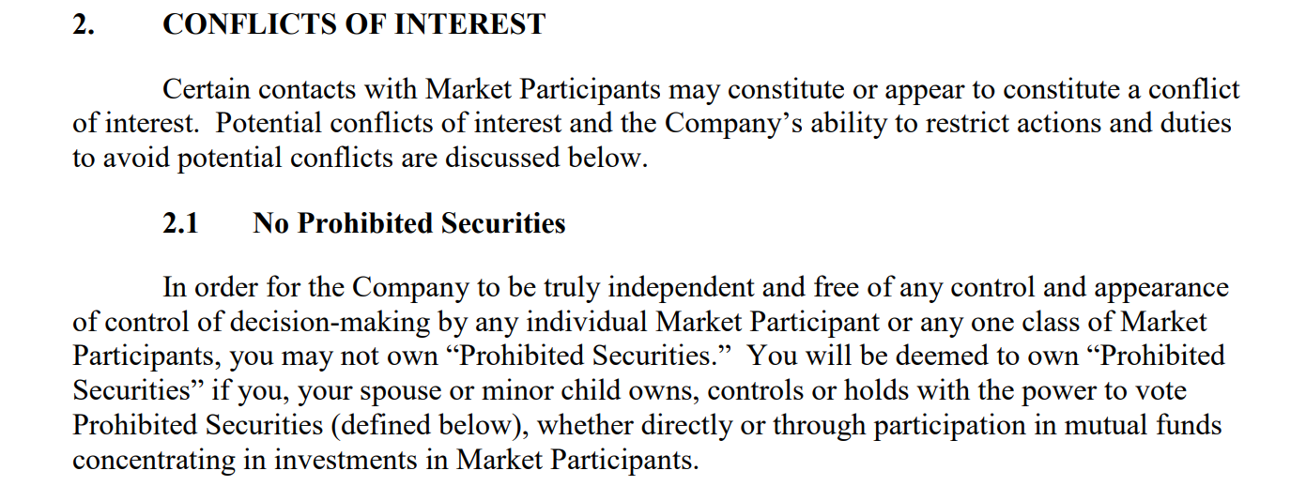
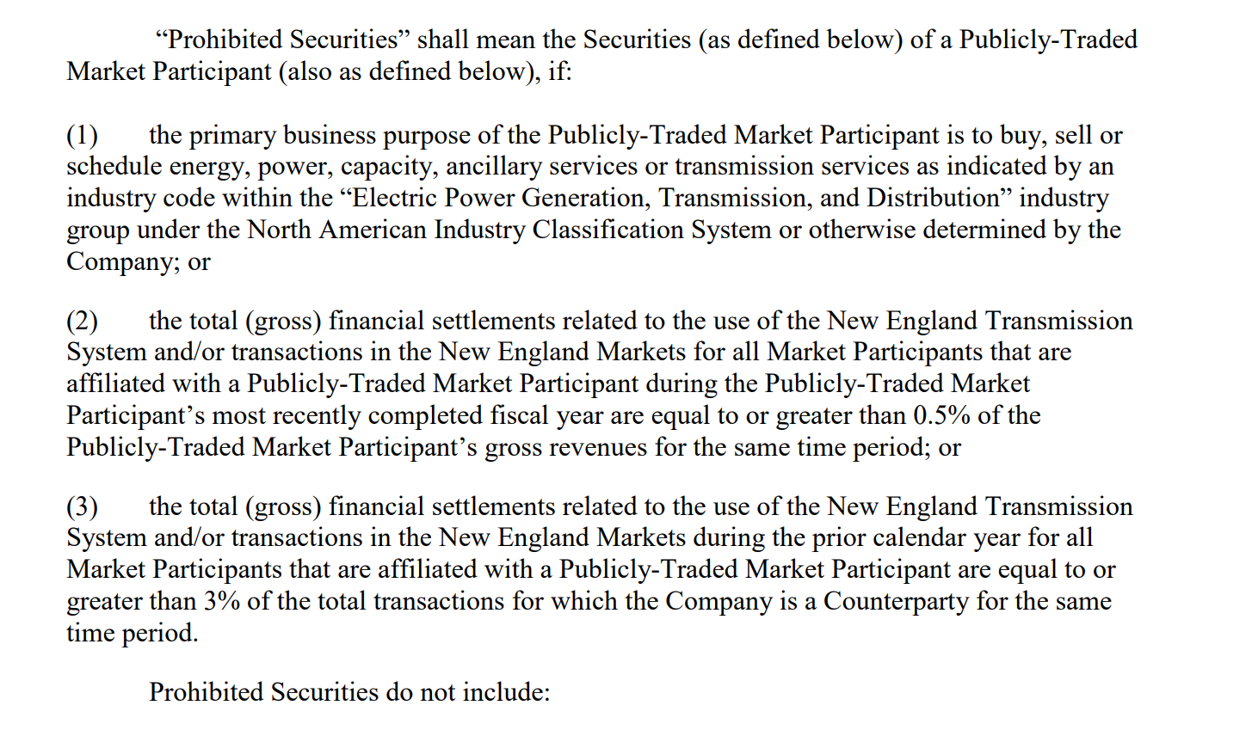
Section 2.1 of ISO’s Current Code of Conduct

Slide 18
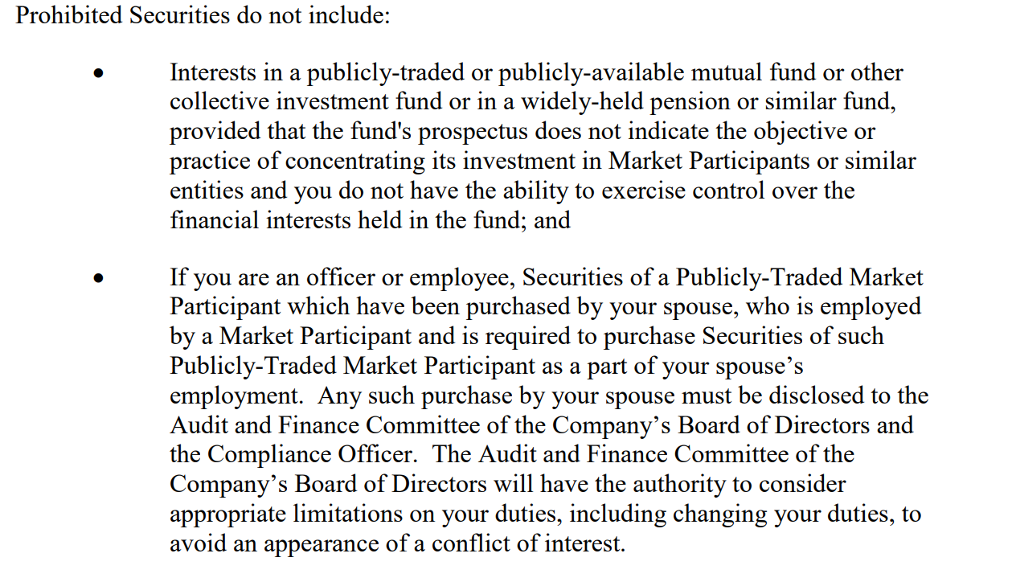
* * *

Slide 19
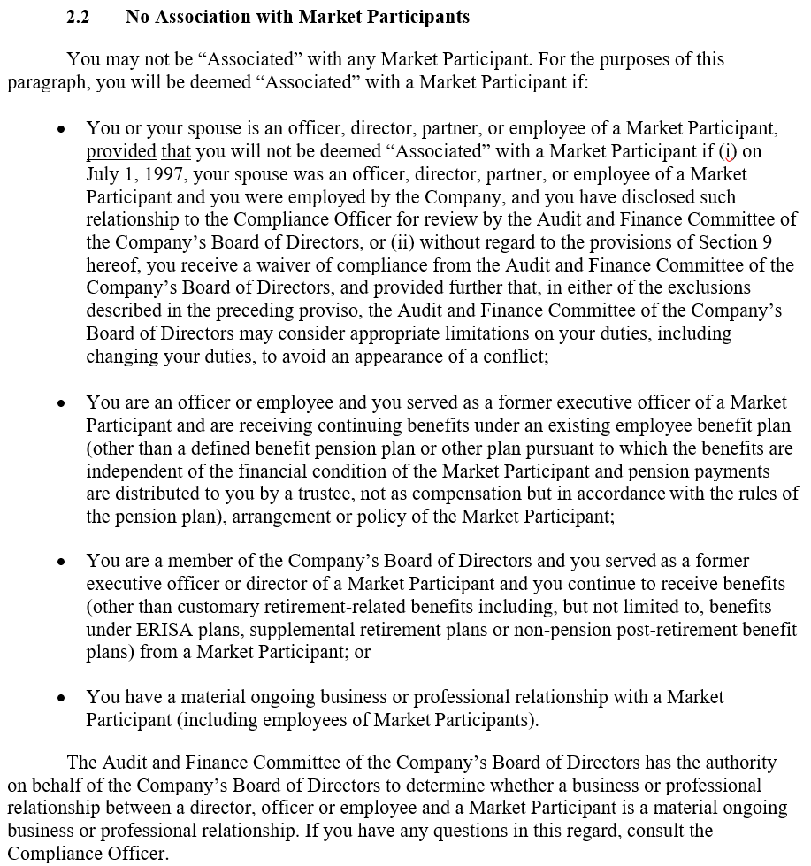
Section 2.2 of ISO’s Current Code of Conduct

